Slide 1
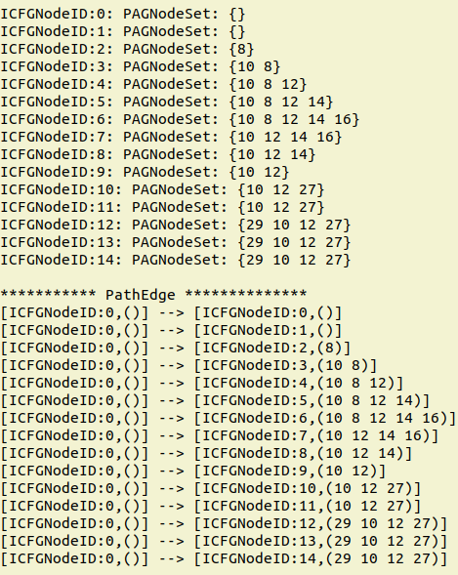
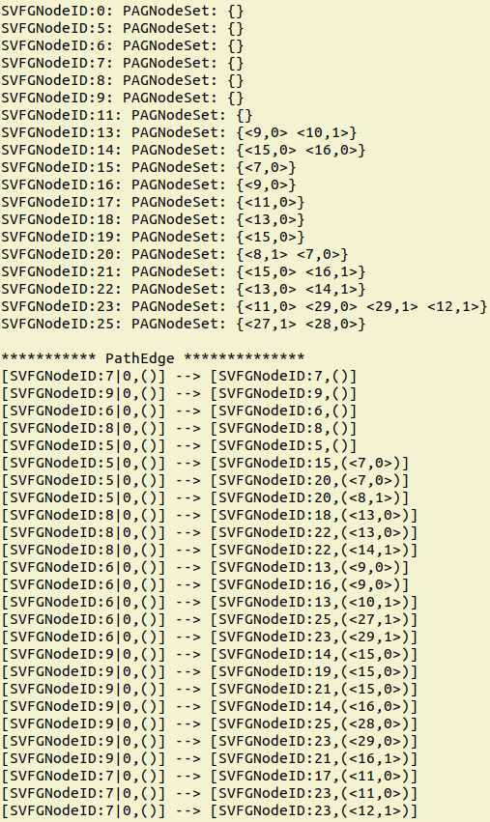
Dataflow fact is propagated along CFG
SPARSE PRECISE
INTERPROCEDURAL
DATAFLOW ANALYSIS
Dataflow fact is only propagated to where it will be used
Notes:
Traditional Dataflow analysis is based on Control Flow Graph, dataflow fact is propagated along CFG, which means under most circumstances, it goes to nodes where it won’t be used. We instead use Value Flow Graph to analysis, dataflow fact is only propagated to where it will be used, thus make the analysis much more time and space efficient.

